Slide 1
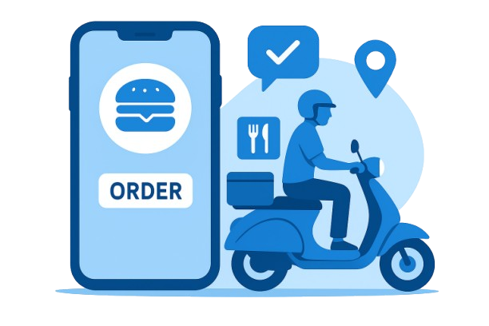
Food ordering and delivery system
Problem statement
Er diagram
Er diagram explanation
SQL code

Slide 2
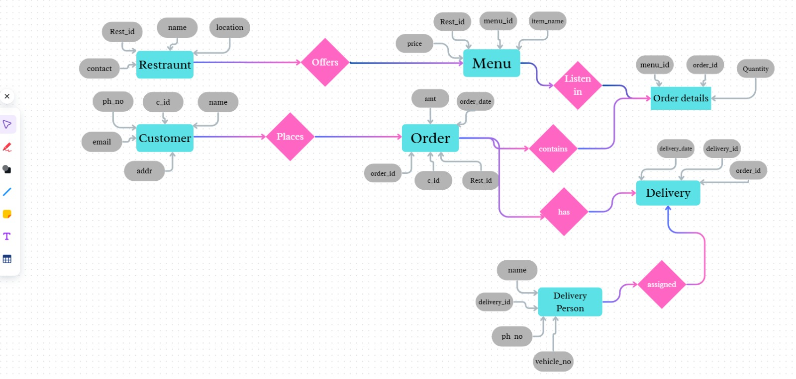
Er diagram

Slide 3
Er diagram explanation
This is an entity relation diagram which shows restaurant food ordering system which includes 7 sub-databases which are:-
1. Restaurant, Menu, Order, Details, Customer, Orders, Delivery, Delivery person.
All sub-databases have extended attributes these 7 sub-databases are co related to each-other.
First database:-Customer’s information
Second database:-Restaurant’s information
Third database:-Information of the menu items
Forth database:-Orders & restaurant
Fifth database:-Order details
Sixth database:-Delivery information
Seventh database:-Delivery person
Customers->Orders: One person can place many orders (1:N)
Restaurant->Menu: One restaurant receives many orders (1:N)
Restaurant->Orders: One restaurant receives many orders (1:N)
Orders->Orders details: One order contains multiple order details (1:N)
Menu->Order Details: One menu item can appear in many order details (1:N)
Orders->Delivery: Each order has one delivery (1:1)
Delivery Person->Delivery : One delivery person can handle many deliveries (1:N)

Slide 4
SQL code
CREATE TABLE Customer (customer id INT PRIMARY KEY, name VARCHAR(50), phone VARCHAR(15), email VARCHAR(50), address VARCHAR(50));
CREATE TABLE Restaurant (restaurant_id INT PRIMARY KEY, name VARCHAR(50), location VARCHAR(100), contact VARCHAR(15));
CREATE TABLE Menu (menu_id INT PRIMARY KEY, restaurant_id INT, item_name VARCHAR(50), price DECIMAL(6,2), FOREIGN KEY (restaurant_id) REFERENCES Restaurant(restaurant_id));
CREATE TABLE Orders (order_id INT PRIMARY KEY, customer_id INT, restaurant_id INT, order_date DATE, total_amount DECIMAL(8,2), rating VARCHAR(20), FOREIGN KEY (customer_id) REFERENCES Customer(customer_id), FOREIGN KEY (restaurant_id) REFERENCES Restaurant(restaurant_id));
CREATE TABLE Order_Details (order_id INT, menu_id INT, quantity INT, PRIMARY KEY(order_id, menu_id), FOREIGN KEY (order_id) REFERENCES Orders(order_id), FOREIGN KEY (menu_id) REFERENCES Menu(menu_id));
CREATE TABLE Delivery_Person (delivery_id INT PRIMARY KEY, name VARCHAR(50), phone VARCHAR(15), vehicle_no VARCHAR(20));
CREATE TABLE Delivery (delivery_id INT, order_id INT, delivery_date DATE, PRIMARY KEY(delivery_id, order_id), FOREIGN KEY (delivery_id) REFERENCES Delivery_Person(delivery_id), FOREIGN KEY (order_id) REFERENCES Orders(order_id));
INSERT INTO Customer (customer_id, name, phone, email, address)
VALUES(1, 'Amit Sharma', '9876543210', 'amit.sharma@email.com', '12 MG Road, Delhi’),
(2, 'Priya Verma', '9123456789', 'priya.verma@email.com', '45 Sadashiv Peth, Pune’),
(3, 'Rahul Mehta', '9988776655', 'rahul.mehta@email.com', '78 FC Road, Pune’);
INSERT INTO Restaurant (restaurant_id, name, location, contact)
VALUES(1, 'Biryani House', 'Connaught Place, Delhi', '9991112222’),
(2, 'Punjabi Zaika', 'Salt Lake, Kolkata', '9993334444’),
(3, 'South Tiffins', 'Baner, Pune', '9995556666’);
INSERT INTO Menu (menu_id, restaurant_id, item_name, price)
VALUES(1, 1, 'Hyderabadi Chicken Biryani', 250.00),
(2, 1, 'Veg Biryani', 200.00),
(3, 1, 'Raita', 50.00),
(4, 2, 'Butter Chicken', 300.00),
(5, 2, 'Paneer Butter Masala', 250.00),
(6, 2, 'Tandoori Roti', 20.00),
(7, 3, 'Masala Dosa', 120.00),
(8, 3, 'Idli Sambhar', 80.00),
(9, 3, 'Filter Coffee', 40.00);

Slide 5
SQL code
INSERT INTO Menu (menu_id, restaurant_id, item_name, price)
VALUES(1, 1, 'Hyderabadi Chicken Biryani', 250.00),
(2, 1, 'Veg Biryani', 200.00),
(3, 1, 'Raita', 50.00),
(4, 2, 'Butter Chicken', 300.00),
(5, 2, 'Paneer Butter Masala', 250.00),
(6, 2, 'Tandoori Roti', 20.00),
(7, 3, 'Masala Dosa', 120.00),
(8, 3, 'Idli Sambhar', 80.00),
(9, 3, 'Filter Coffee', 40.00);
INSERT INTO Orders (order_id, customer_id, restaurant_id, order_date, total_amount, rating)
VALUES(101, 1, 1, '2025-09-01', 550.00, '4/5’),
(102, 2, 2, '2025-09-02', 360.00, '4/5’),
(103, 3, 3, '2025-09-03', 240.00, '3/5’),
(104, 1, 2, '2025-09-04', 290.00, '5/5’);
INSERT INTO Order_Details (order_id, menu_id, quantity)
VALUES(101, 1, 2),
(101, 3, 2), (102, 4, 1),
(102, 6, 3), (103, 7, 1),
(103, 8, 2), (103, 9, 1),
(104, 5, 1), (104, 6, 4);
INSERT INTO Delivery_Person (delivery_id, name, phone, vehicle_no)
VALUES(1, 'Ravi Kumar', '9001112233', 'DL01AB1234’),
(2, 'Sneha Iyer', '9004445566', 'MH12XY5678’),
(3, 'Arjun Nair', '9007778899', 'MH12CD9012’);
INSERT INTO Delivery (delivery_id, order_id, delivery_date)
VALUES(1, 101, '2025-09-01’),
(2, 102, '2025-09-02’),
(3, 103, '2025-09-03’),
(1, 104, '2025-09-04’);
SELECT * FROM Customer;
SELECT * FROM Restaurant;
SELECT * FROM Menu;
SELECT * FROM Orders;
SELECT * FROM Order_Details;
SELECT * FROM Delivery;
SELECT * FROM Delivery_Person;

Slide 6
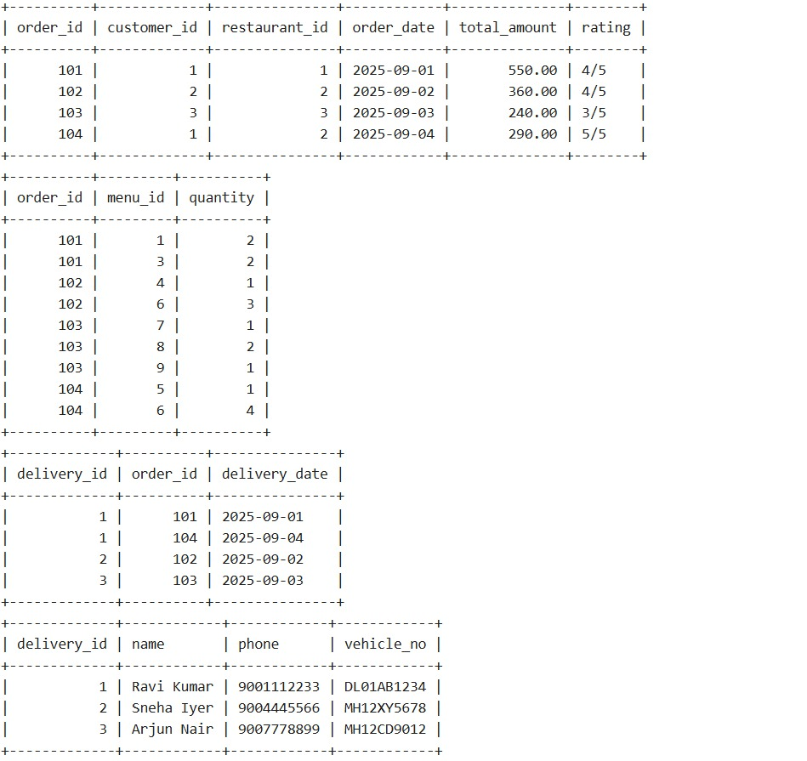
Output

Slide 7
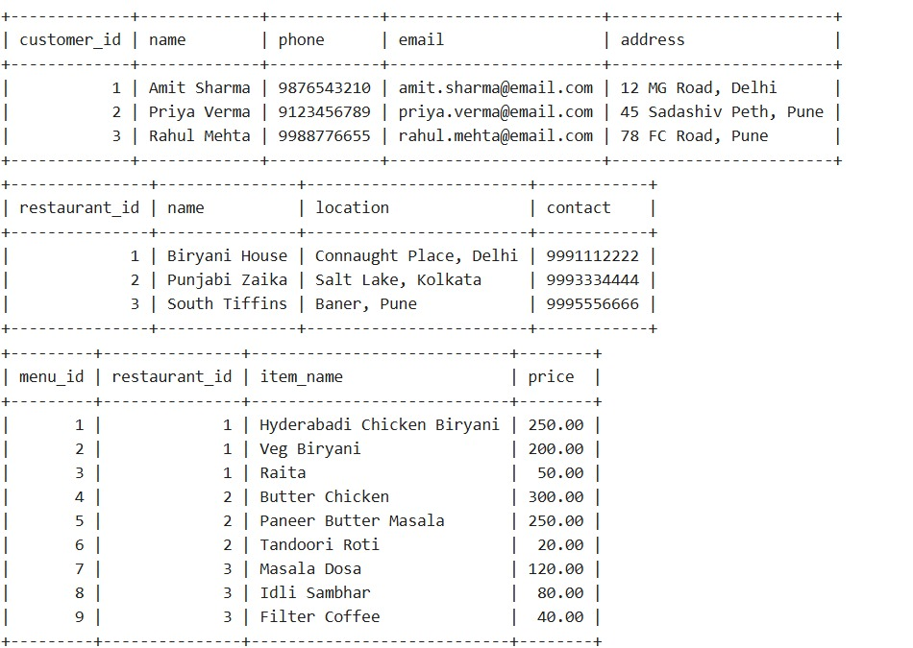
Output

Slide 8
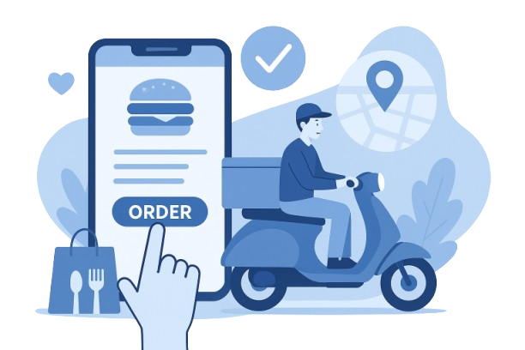
Thank you
Credits:-
Sejal Mudkhedkar – Roll no.: 2
Mrunmayee Katruwar – Roll no.: 15
Rutuja Achyut – Roll no.: 65
Swanandi Wadghule – Roll no.: 72
Namya Prasad – Roll no.: 74

